Slide 1

Encl. A
Department of Texas, The American Legion
Strategic Long-Range Planning - T3 Brief
& Membership
Presented by Chairman, Paul J. Goymerac, 25 SEP 2026 (Ver 2)

Slide 2

Purpose
Utilize this slide deck as a Train the Trainer (T3)document that can help educate fellow Legionnaires regarding the Texas American Legion Strategic Plan and provide information on how to submit feedback to help create/improve a “Train the Trainer” slide deck for future use.
2

Slide 3
Agenda
Problem Statement
Nested Mission, Vision, and Priorities
Explaining Elements of Long-Range Strategic Plan/Map
Summary of Long-Range Strategic Plan
Why is the Strategic Plan Important, “So What” question
Strategic Plan Key Stakeholders
Questions or Comments
Backup Slides
3

Slide 4
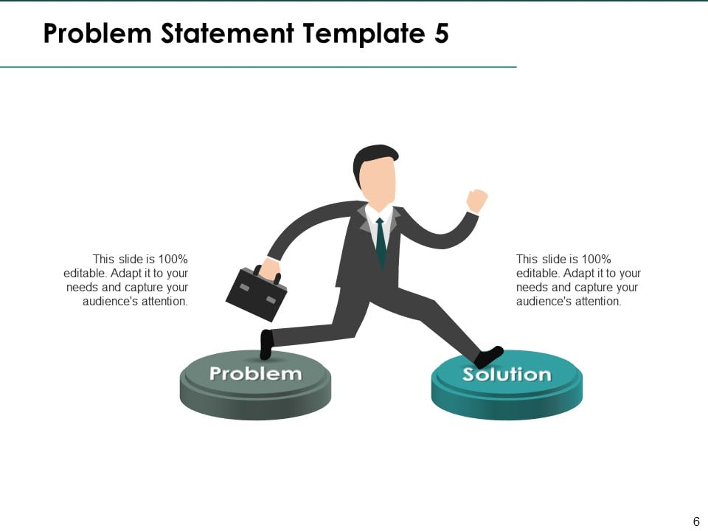
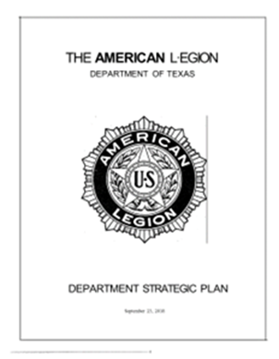
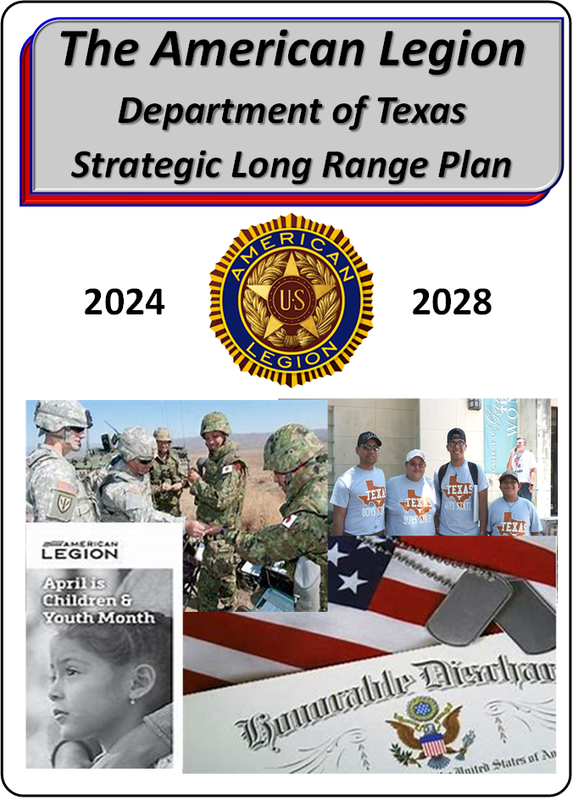
Problem Statement
The American Legion Department of Texas fails to maintain a current 5-year Long Range Strategic Plan that is executable, measurable, and accounts for recent significant changes world-wide that are impacting The American Legion’s ability to support our Veterans, their families, and the Nation as a whole.
2018
2026 - 2030
4

Slide 5
I
Nested Priorities and Objectives
MISSION: The American Legion Strives to serve the needs of all veterans and their families; To promote a better understanding of the principles of democracy; To inculcate among all people a higher appreciation of the benefits of American citizenship and to fulfill our commitment to community, state and nation.
VISION: Be a values-based organization committed to serving God, country, community and all Veterans today, tomorrow, and throughout 21st Century.
PRIORITIES: Focus on service to Veterans, Families, and to the community. Legion officers at every level will lead the way in reinforcing the Vision.
“Adapt and Innovate to Remain Relevant for our Veterans”
5

Slide 6
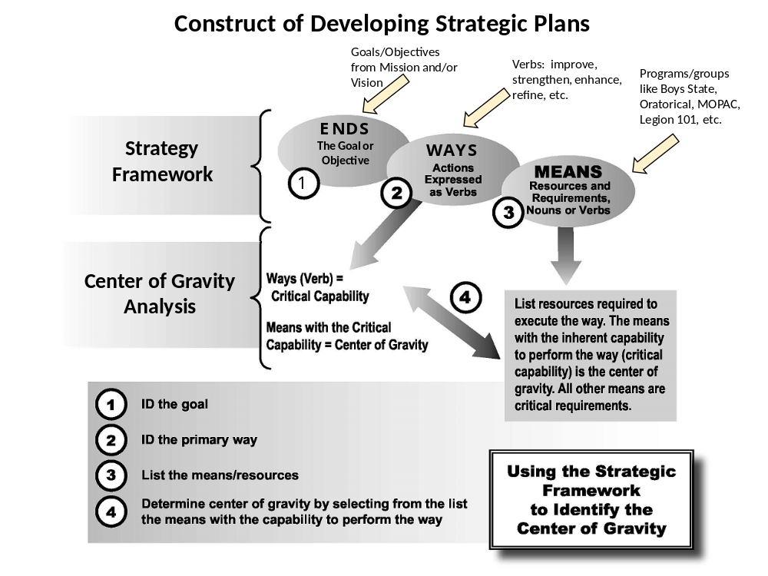
CoG: Membership
Membership
6

Slide 7
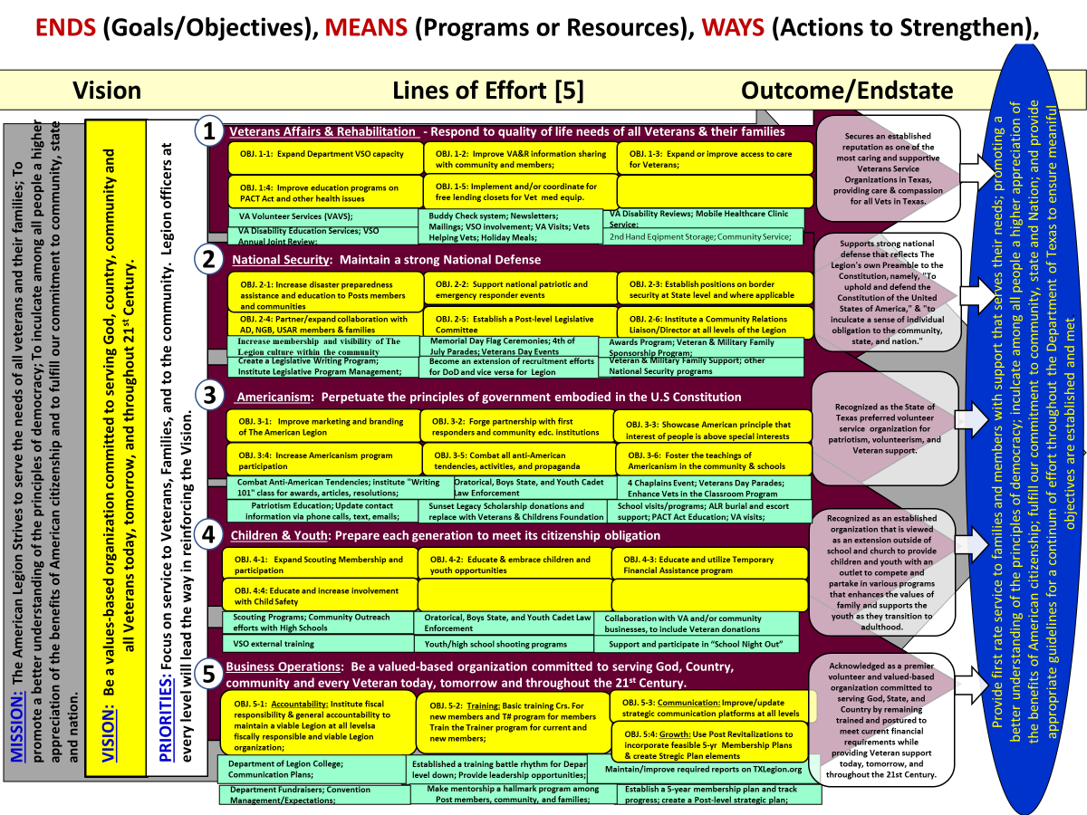
7

Slide 8
Vision Lines of Effort [5] Outcome/Endstate
1
MISSION: The American Legion Strives to serve the needs of all veterans and their families; To promote a better understanding of the principles of democracy; To inculcate among all people a higher appreciation of the benefits of American citizenship and to fulfill our commitment to community, state and Nation.
2
3
MISSION: The American Legion Strives to serve the needs of all veterans and their families; To promote a better understanding of the principles of democracy; To inculcate among all people a higher appreciation of the benefits of American citizenship and to fulfill our commitment to community, state and nation.
PRIORITIES: Focus on service to Veterans, Families, and to the community. Legion officers at every level will lead the way in reinforcing the Vision.
VISION: Be a values-based organization committed to serving God, country, community and all Veterans today, tomorrow, and throughout 21st Century.
VISION: Be a values-based organization committed to serving God, country, community and all Veterans today, tomorrow, and throughout 21st Century.
4
PRIORITIES: Focus on service to Veterans, Families, and to the community. Legion officers at every level will lead the way in reinforcing the Vision.
5
8

Slide 9
ENDS (Goals/Objectives), MEANS (Programs or Resources), WAYS (Actions to Strengthen),
Vision Lines of Effort [5] Outcome/Endstate
1
Veterans Affairs & Rehabilitation - Respond to quality of life needs of all Veterans & their families
Dept. Vice Cdr, 3rd Div: Districts 1, 2, 9, 13, 16
2
National Security: Maintain a strong National Defense
Dept. Vice Cdr, 2nd Div: Districts 3, 6, 10, 17, 22
3
Americanism: Perpetuate the principles of government embodied in the U.S Constitution
MISSION: The American Legion Strives to serve the needs of all veterans and their families; To promote a better understanding of the principles of democracy; To inculcate among all people a higher appreciation of the benefits of American citizenship and to fulfill our commitment to community, state and nation.
Dept. Vice Cdr, 1st Div: Districts 4, 7, 14, 18, 23
PRIORITIES: Focus on service to Veterans, Families, and to the community. Legion officers at every level will lead the way in reinforcing the Vision.
VISION: Be a values-based organization committed to serving God, country, community and all Veterans today, tomorrow, and throughout 21st Century.
4
Children & Youth: Prepare each generation to meet its citizenship obligation
Dept. Vice Cdr, 4th Div: Districts 5, 8, 15, 21
5
Business Operations & Membership: Be a valued-based organization committed to serving God, Country, community and every Veteran today, tomorrow and throughout the 21st Century.
LRPC Sub-Chairman, Districts 11, 12, 19, 20
9

Slide 10
ENDS (Goals/Objectives), MEANS (Programs or Resources), WAYS (Actions to Strengthen),
Vision Lines of Effort [5] Outcome/Endstate
1
Veterans Affairs & Rehabilitation - Respond to quality of life needs of all Veterans & their families
Secures an established reputation as one of the most caring and supportive Veterans Service Organizations in Texas, providing care & compassion for all Vets in Texas.
OBJ. 1-1: Expand Department VSO capacity
OBJ. 1-2: Improve VA&R information sharing with community and members;
OBJ. 1-3: Expand or improve access to care for Veterans;
Ends – Goals/Objectives
OBJ. 1:4: Improve education programs on PACT Act and other health issues
OBJ. 1-5: Implement and/or coordinate for free lending closets for Vet med equip.
VA Volunteer Services (VAVS);
Buddy Check system; Newsletters; Mailings; VSO involvement; VA Visits; Vets Helping Vets; Holiday Meals;
VA Disability Reviews; Mobile Healthcare Clinic Service;
Ways – How to change
VA Disability Education Services; VSO Annual Joint Review;
2nd Hand Equipment Storage; Community Svcs;
Supports strong national defense that reflects The Legion's own Preamble to the Constitution, namely, "To uphold and defend the Constitution of the United States of America," & "to inculcate a sense of individual obligation to the community, state, and nation."
2
National Security: Maintain a strong National Defense
Means – Programs
OBJ. 2-1: Increase disaster preparedness assistance and education to Posts members and communities
OBJ. 2-2: Support national patriotic and emergency responder events
OBJ. 2-3: Establish positions on border security at State level and where applicable
Outcome Measured
OBJ. 2-4: Partner/expand collaboration with AD, NGB, USAR members & families
OBJ. 2-5: Establish a Post-level Legislative Committee
OBJ. 2-6: Institute a Community Relations Liaison/Director at all levels of the Legion
Increase membership and visibility of The Legion culture within the community
Memorial Day Flag Ceremonies; 4th of July Parades; Veterans Day Events
Awards Program; Veteran & Military Family Sponsorship Program;
Create a Legislative Writing Program; Institute Legislative Program Management;
Become an extension of recruitment efforts for DoD and vice versa for Legion
Veteran & Military Family Support; other National Security programs
Endstate – synch’d desire
Provide first rate service to families and members with support that serves their needs; promoting a better understanding of the principles of democracy; inculcate among all people a higher appreciation of the benefits of American citizenship; fulfill our commitment to community, state and Nation; and provide appropriate guidelines for a continum of effort throughout the Department of Texas to ensure meaniful objectives are established and met.
3
Recognized as the State of Texas preferred volunteer service organization for patriotism, volunteerism, and Veteran support.
Americanism: Perpetuate the principles of government embodied in the U.S Constitution
1
- Line of Effort
OBJ. 3-1: Improve marketing and branding of The American Legion
OBJ. 3-2: Forge partnership with first responders and community edc. institutions
OBJ. 3-3::Showcase American principle that interest of people is above special interests
OBJ. 3:4: Increase Americanism program participation
OBJ. 3-5: Combat all anti-American tendencies, activities, and propaganda
OBJ. 3-6: Foster the teachings of Americanism in the community & schools
Combat Anti-American Tendencies; institute "Writing 101" class for awards, articles, resolutions;
Oratorical, Boys State, and Youth Cadet Law Enforcement
4 Chaplains Event; Veterans Day Parades; Enhance Vets in the Classroom Program
Patriotism Education; Update contact information via phone calls, text, emails;
Sunset Legacy Scholarship donations and replace with Veterans & Childrens Foundation
School visits/programs; ALR burial and escort support; PACT Act Education; VA visits;
Recognized as an established organization that is viewed as an extension outside of school and church to provide children and youth with an outlet to compete and partake in various programs that enhances the values of family and supports the youth as they transition to adulthood.
4
Children & Youth: Prepare each generation to meet its citizenship obligation
OBJ. 4-1: Expand Scouting Membership and participation
OBJ. 4-2: Educate & embrace children and youth opportunities
OBJ. 4-3: Educate and utilize Temporary Financial Assistance program
OBJ. 4:4: Educate and increase involvement with Child Safety
Scouting Programs; Community Outreach efforts with High Schools
Oratorical, Boys State, and Youth Cadet Law Enforcement
Collaboration with VA and/or community businesses, to include Veteran donations
VSO external training
Youth/high school shooting programs
Support and participate in “School Night Out”
5
Business Operations & Membership: Be a valued-based organization committed to serving God, Country, community and every Veteran today, tomorrow and throughout the 21st Century.
Acknowledged as a premier volunteer and valued-based organization committed to serving God, State, and Country by remaining trained and postured to meet current financial requirements while providing Veteran support today, tomorrow, and throughout the 21st Century.
OBJ. 5-1: Accountability: Institute fiscal responsibility & general accountability to maintain a viable Legion at all levelsa fiscally responsible and viable Legion organization;
OBJ. 5-2: Training: Basic Training Crs. for new members and a virtual Train the Trainer program
OBJ. 5-3: Communication: Improve/update strategic communication platforms at all levels
OBJ. 5-4: Growth: Use Post Revitalizations to incorporate feasible 5-yr Membership Plans & create Strategic Plan elements
Department of Legion College; Communication Plans;
Established a training battle rhythm for Department level down; Provide leadership opportunities;
Maintain/improve required reports on TXLegion.org
Department Fundraisers; Convention Management/Expectations;
Make mentorship a hallmark program among Post members, community, and families;
Establish a 5-year membership plan and track progress; create a Post-level strategic plan;
10

Slide 11

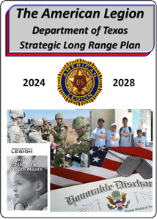
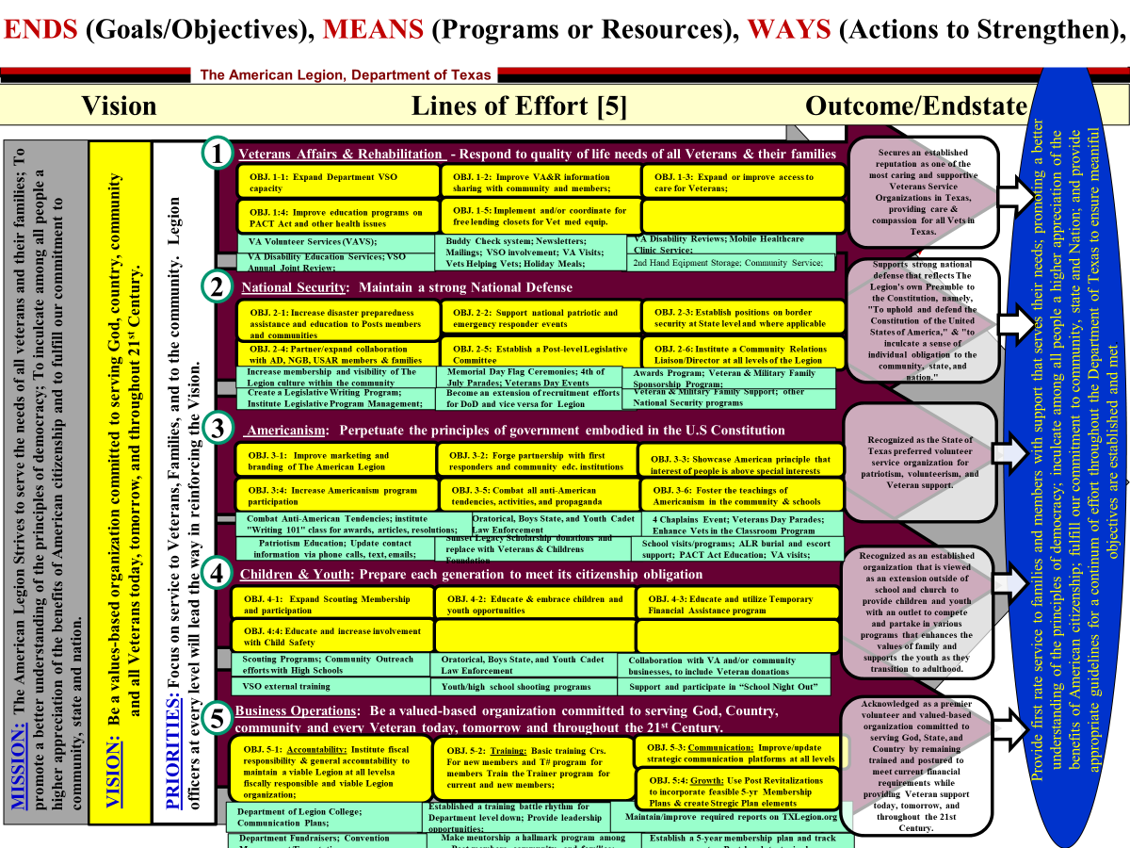
CU
I
Summary of Long Range Strategic Plan
Vision for The American Legion 2026 through 2030 –
    “Respond to quality of life issues; meet citizenship obligations; maintain strong National Defense; Perpetuate the principles of government embodied in the U.S. Constitution; Maintain a values-based organization committed to God, Country, Community and all Veterans”.
  Strengthening The American Legion’s business operations.
  Strategic Approach through significant Lines of Effort (LOEs)*:
2018
American Legion Dept.
Strategic Plan
LOE1: Veterans Affairs & Rehabilitation
LOE2: National Security
LOE3: Americanism
LOE4: Children and Youth
LOE5: Business Operations &
Membership
* w/associated planning objectives
2026
2030
2026 - 2030 Long Range Strategy Plan
11

Slide 12
CU
I
Why is this important to you?
“Be part of the solution, not the problem”
Great ideas are best when they come from the bottom-up
We need your questions and recommendations for improvement
Need Post leadership and members to be engaged; support the Texas Legion Strategic Plan which is nested under the National Plan
We need your feedback via surveys so we can measure success
“If your Post does not have a strategic plan, you should consider initiating one that is nested under the State of Texas….does not have to be as elaborate as the State”
12

Slide 13
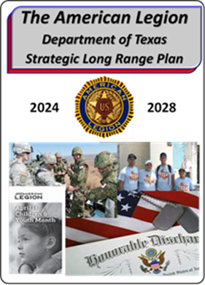

Get yourself a copy online and/or take a Post survey. Both are located at the following site:
https://txlegion.org/strategicplan/
2026
2030
(Updates to site are in progress)
13

Slide 14
LOE Assignments & District Representation:
LOE #1: Veterans Affairs & Rehabilitation (VA&R) – 3rd Division Dept. Vice Commander, Districts 1, 2, 9, 13, 16
LOE #2: National Security – 2nd Division Dept. Vice Commander, Districts 3, 6, 10, 17, 22
LOE #3: Americanism – 1st Division Dept. Vice Commander, Districts 4, 7, 14, 18, 23
LOE #4: Children & Youth – 4th Division Dept. Vice Commander, Districts 5, 8, 15, 21
LOE #5: Business Operations – LRPC Member at Large, Districts 11, 12, 19, 20
Long Range Planning Committee (LRPC) Structure & Responsibilities
Under the current LRPC structure, members of the committee include the following:
Positions Name LOE Facilitator______________
Chairman Paul Goymerac** (2028)
LRPC Vice Chairperson Kimberly Biggerstaff* (2028)
1st Div., Dept. Vice Commander W.S. Turner (2027) Paul Goymerac (LOE #1)
2nd Div., Dept. Vice Commander Cheryl Williams (2027) Kimberly Biggerstaff (LOE #2)
3rd Div., Dept. Vice Commander Eric Mayer (2027) Steve Farrell (LOE #3)
4th Div., Dept. Vice Commander Jeff Meuer (2027) Wayne Gherl (LOE #4)
5th LOE Lead/Member at Large Christie Young (2029) Lenore Hackenyos (LOE #5)
Member at Large Lenore Hackenyos (2029)
* Current Vice Chairperson agreed to stay on past 2026, new State Commander supports.
** Agreed to stay on as Chairman past 2026, new State Commander supports.
14

Slide 15
Questions or Comments
15

Slide 16
Backup Slides
16

Slide 17
Key Acronyms/Definitions
Obj/OBJ | Objective(s)
AD | Active Duty
ALR | American Legion Riders
AUX | American Legion Auxiliary
BLUF | Bottom Line Up Front
Cdr/CDR | Commander
DEC | Dept. Executive Committee
Dept. | Department
DoD | Dep’t of Defense
HQs | Headquarters
i.e. | For Example
LOE | Line of Effort
LRSP | Long Range Strategic Plan
MOPAC | Membership Org. Post Activities Committee
NEC | Nat’l Executive Committee
NGB | Nat’l Guard Bureau
PACT ACT | Promise to Address Comprehensive Toxics Act
POA&M | Plan of Action & Milestones
Pt. | Point
SAL | Sons of the American Legion
T3 | Train the Trainer
TBD | To Be Determined
USAR | US Army Reserve
VAVS | VA Volunteer Service
VSO | Veterans Service Officer
Definitions
LOE Definition - Line of Effort towards a developed strategy that is a concentrated effort towards a desired endstate or outcome.
Ends - Objectives toward which one strives to meet
Means - Instruments or process/procedure by which some end can be achieved
Measures – A quantifiable marker to determine if efforts are effective or efficient
Ways - Courses of Action taken to meet objectives
Survey Analysis Report - Summary report that indicates progress of measures as either RED (requires improvement), AMBER (status quo), or GREEN (Significant improvements made). Measures will help determine what parameters were set for each objective to meet a Red, Amber. Or Green status. This report is a snap-shot in time and updated quarterly, semi-annually, or annually.
LRSP Colors
Maroon: Line of Effort
Yellow: Objectives or Vision
Green: Events/Actions/Items
Blue: Endstate
17

Slide 18
Line of Effort (LOE) Structure & Responsibilities
This document outlines the structure and responsibilities for the five Lines of Effort (LOEs) supporting the Texas Legion’s Strategic Long Range Plan.
LOE Leadership & Chain of Responsibility:
Texas Vice Commanders and the Assistant Chairman for Long Range Planning Committee (LRPC) serve as LOE Leads. These leads maintain both a traditional Legion chain of responsibility (through their Vice Commander role) and a technical chain focused on the assigned LOE. The technical chain is supported by District Commanders or their designated representatives. To ensure comprehensive representation across the state, each LOE includes members from all four Divisions. The standard Legion structure aligns 23 Districts under one of the four Divisions, based on geographic location.
Technical Chain & Objective Management:
Each LOE already has established Objectives (detailed on previous slides) developed which came from the LRPC over the past two years. As issues and challenges are identified, LOE Leads will address them, leveraging existing standing committees. Resolutions and Committee Action Plans may also be utilized to help drive progress.
LOE Leads will track progress on all working objectives and provide updates at the Department Convention, Fall Department Executive Committee (DEC) meeting, and Mid-winter Conference. Leads should be prepared to present a concise summary of progress for objectives categorized under specific timeframes:
Short-Range: (1-2 years)
Mid-Range: (3-5 years)
Long-Range: (5+ years)
The attached summary template is recommended to standardize LOE reporting. LOE Leads retain the flexibility to modify, add, or delete objectives as needed, with assistance from District Committee members representing all Divisions. The Texas Legion Long Range Plan is a dynamic document, subject to continuous improvement.
18

Slide 19
LRPC Members & Volunteers – Structure and Responsibilities
The committee members listed as LOE facilitators will serve as facilitators for change. They will assist with efforts to develop, implement, and track objectives. More importantly, they will serve as the continuity each year between those legionnaires who transition out of the LRPC. When necessary, facilitators will schedule and conduct integrated zoom sessions for their LOE. Once a Long-Range Training Program is developed and rolled out, the facilitators will help get the training in the hands of Posts and Districts. Facilitators will also help Vice Commanders obtain, analyze, and understand data from the District and Post surveys. Additionally, they will help LOE leads build a deeper bench of sub-committee members/volunteers as needed. Volunteers will augment LRPC members as additional change agents.
Besides serving as a LOE facilitator, the Chairman and Vice Chairperson will collect Texas Legion Committee Action Plans and serve as a liaison between the various committees and LRPC. They will address any recommended changes and engage accordingly with the appropriate committees and Legion Family leadership. More importantly, they will collaborate with the HQs staff for required resources and brief the Legion leadership on LRPC progress.
Division Commander Role:
Division Commanders (Dept. Vice Cdrs) or LOE Leads will provide standard support, mentorship, and education regarding the Strategic Long-Range Plan. They will have access to relevant survey data and emphasize the importance of District-level engagement. Surveys are encouraged whenever Commanders change to ensure current data is captured and change priorities can be developed. If surveys are not used as a mechanism or vehicle to identify Post/District weaknesses and strengths, then open dialogue between Post and District leadership will be necessary. The primary objective is to identify problems and develop a plan to fix, strengthen, or maintain processes accordingly. Division Commanders will also be responsible for LOE reporting at the 3 major conferences each year. Division Commanders or LOE Leads are the positions covered by the Department Vice Commander except for LOE #5, which is covered by LRPC Member at Large.
Plan Modification & Contact Information:
All Posts, Districts, and Division leaders are encouraged to submit requests for changes to objectives, priorities, or other elements of the Strategic Plan to maintain its relevance and measurability. For additional guidance regarding the Texas Legion’s Long-Range Plan, please contact Chairman Paul Goymerac, Post 593, Converse, Texas.
19

Slide 20
Long Range Plan Templated Conference Report
LOE # ____
LOE Lead ____________________
Short-Range (1-2 years) Update:
Objective and Brief Summary:
Action Plan Start:
Action Plan Progress Summary:
Expected Action Plan Completion:
Mid-Range (3-5 years) Update:
Objective and Brief Summary:
Action Plan Start:
Action Plan Progress Summary:
Expected Action Plan Completion:
Long-Range (Over 5 years) Update:
Objective and Brief Summary:
Action Plan Start:
Action Plan Progress Summary:
Expected Action Plan Completion:
20

Slide 21
Long Range Plan Example Conference Report
LOE # 5: Lead - Clayton Wallers
Short-Range (1-2 years) Update:
Objective and Brief Summary: OBJ. 5-2: Training: Virtual Train the Trainer program for Strategic Planning.
Action Plan Start: SEP 2025
Action Plan Progress Summary: Discussion began on developing a Train the Trainer virtual course to educate Post and District members on the Texas Long Range Plan. Development must be under the purview of the Training Committee and then constructed/managed by LOE #5. Intent is for a 15 minute virtual training session that can be used at Post or District meetings and available for download. Paul Goymerac, Post 593, has the lead on this Short-Range action.
Expected Action Plan Completion: MAY 2026
Mid-Range (3-5 years) Update: Rated
Objective and Brief Summary: OBJ. 5-3: Communication: Improve/update strategic communication platforms
Action Plan Start: 18 July 2023
Action Plan Progress Summary: As requested in Resolution 12-22, LOE 5 is working at developing a mid-range communication platform to store electronic documents and create a standardized format for the naming convention of documents. Identification of what documents need to be electronically saved is ongoing. Slow start for this objective and identification of a lead is required. Virtual IPR via MS Teams will be conducted in October 2025.
Expected Action Plan Completion: SEP 2027 – JAN 2028 timeframe
Long-Range (Over 5 years) Update:
Objective and Brief Summary: OBJ. 5-5: Update the Strategic Plan (New): Change the format of the current Strategic Plan to better reflect or mirror “21st Century Report”. This concept may enable the long-range plan to augment or support the content of the 21st Century Report. The two should go hand in hand. Discussion about change efforts to the current framework of the Texas Legion Long Range Plan must be discussed during online IPRs between now and Mid-winter Session in 2026.
Action Plan Start: Still developing a feasible concept of change
Action Plan Progress Summary: Infant stages, long-range changes
Expected Action Plan Completion: 2030 - 2032
Example
21

Slide 22
Long Range Plan Example Conference Report
Chairman Conference Rollup Report
Short-Range Mid-Range Long-Range
LOE #1:
LOE #2:
LOE #3:
LOE #4:
LOE #5:
Example
LRPC Comments: LOE #4 (S-R) and LOE #1 (M-R) is ready for movement to the Finance Committee. LOE #5 (S-R) is ready for Training Committee. LOE #2 (S-R) is complete and can be closed out. LOE Reports attached. 19 SEP 2025
Complete or ready for implementation
On target for change, working issues
Infant stages or existing complications
22

Slide 23
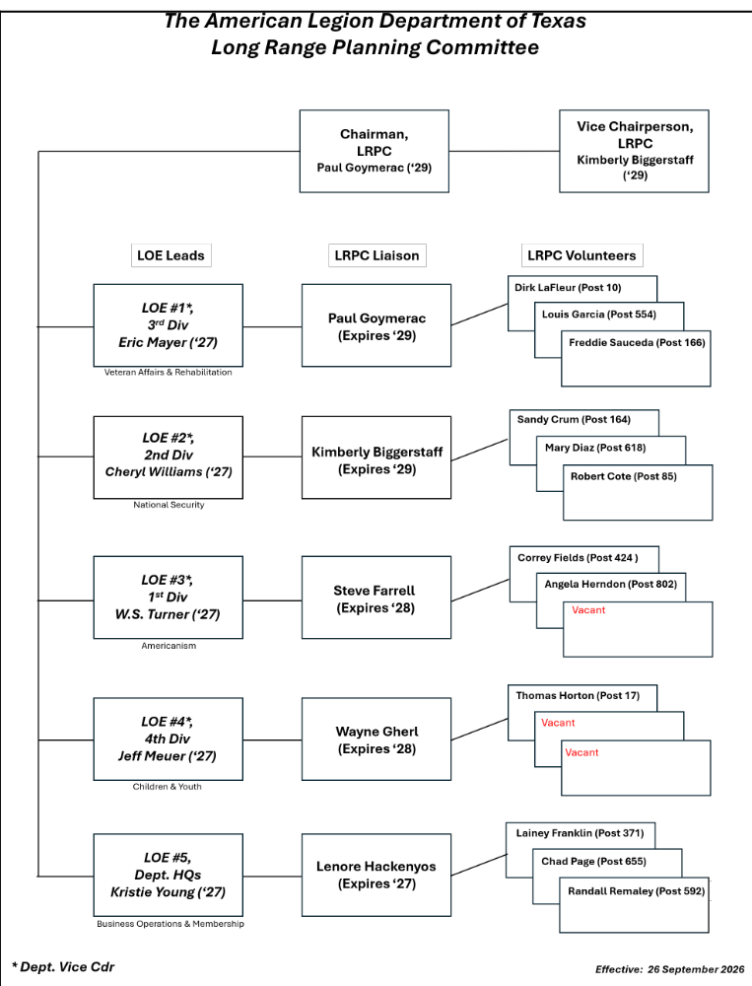
LRPC Org. Chart

Slide 24
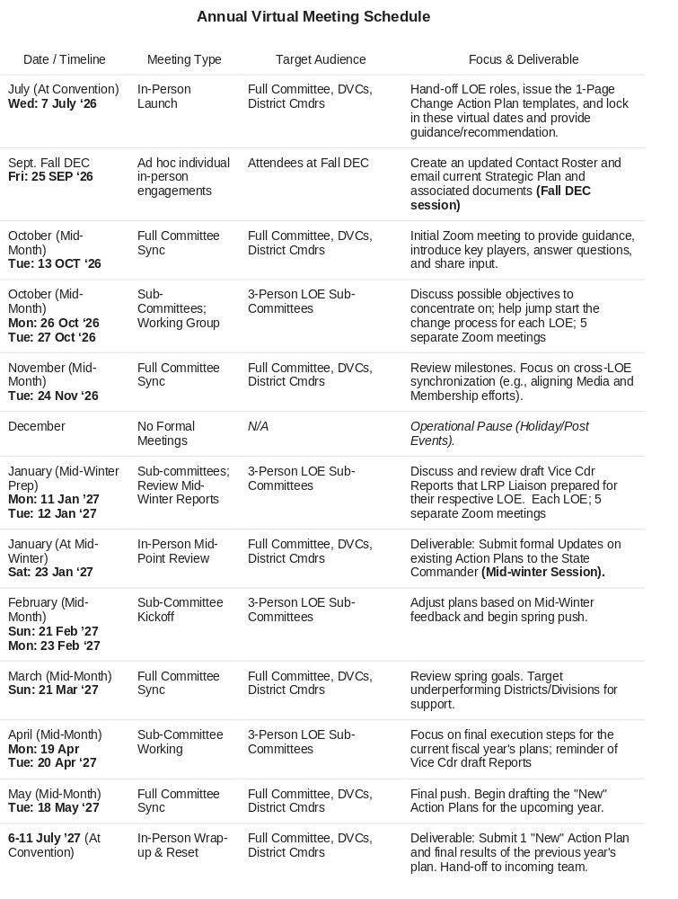
Zoom Meetings

Slide 25
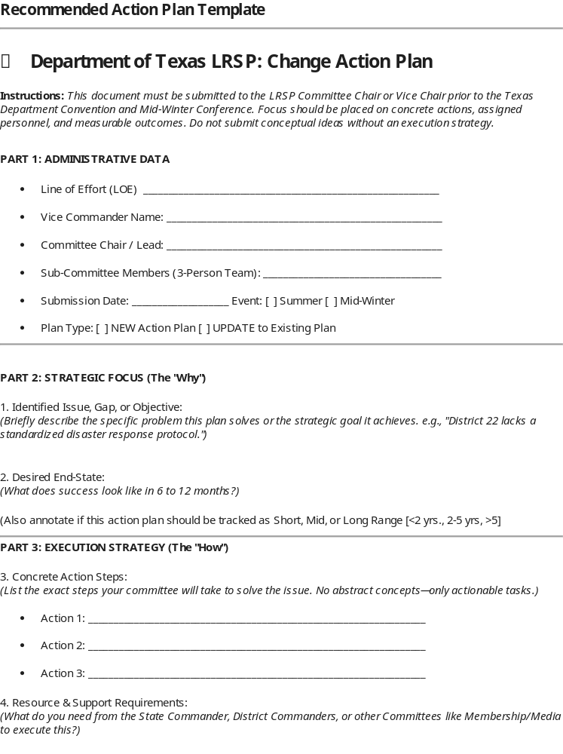
Change Action Plan

Slide 26
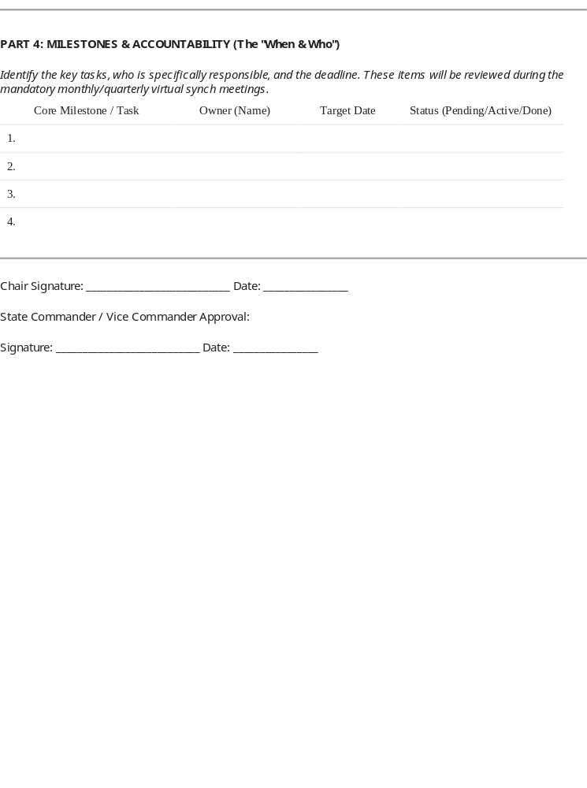
Change Action Plan
(Continued)

